Slide 1


CRED: Counterfactual Reasoning and Environment Design for Active Preference Learning
Yi-Shiuan Tung, Bradley Hayes, Alessandro Roncone
University of Colorado Boulder
Notes:
Different colors for important keywords

Slide 2
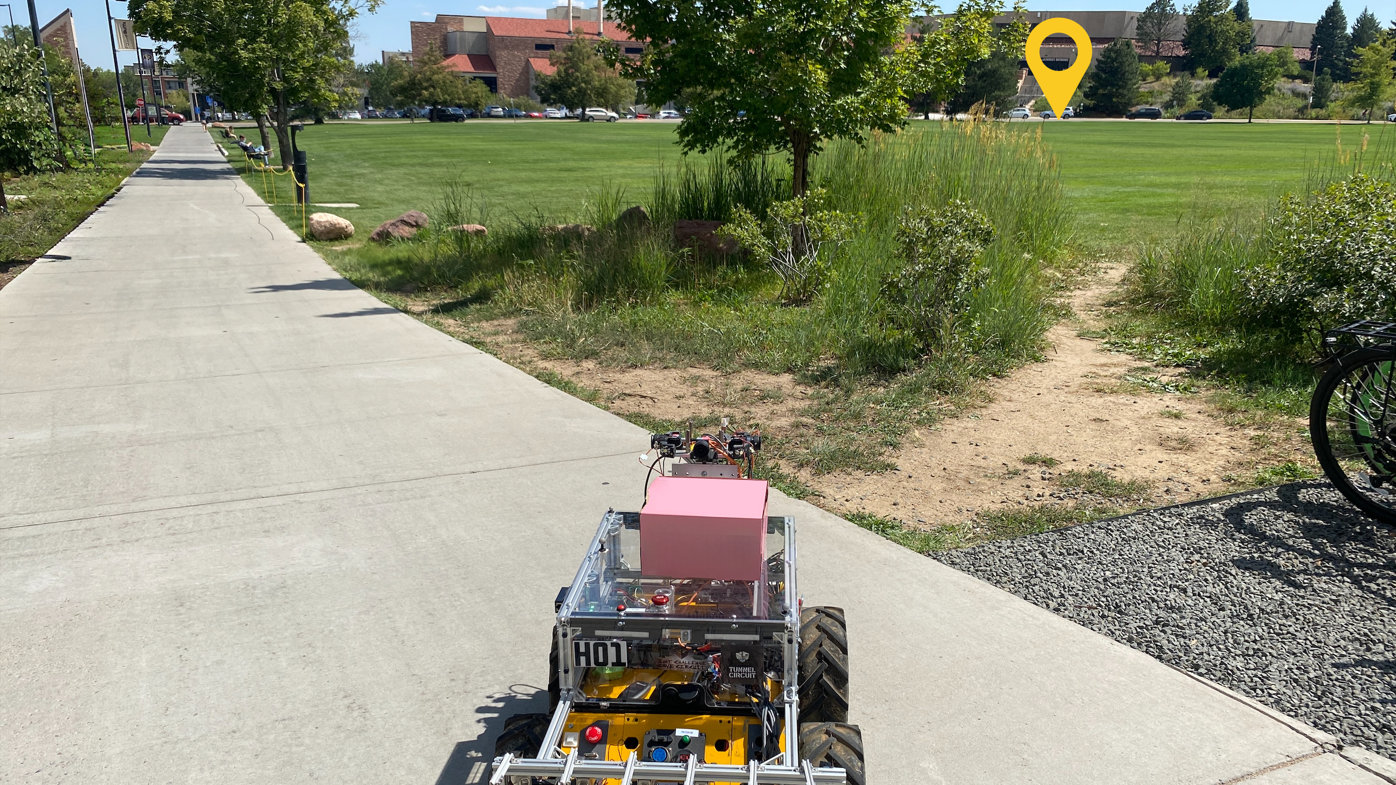

Slide 3
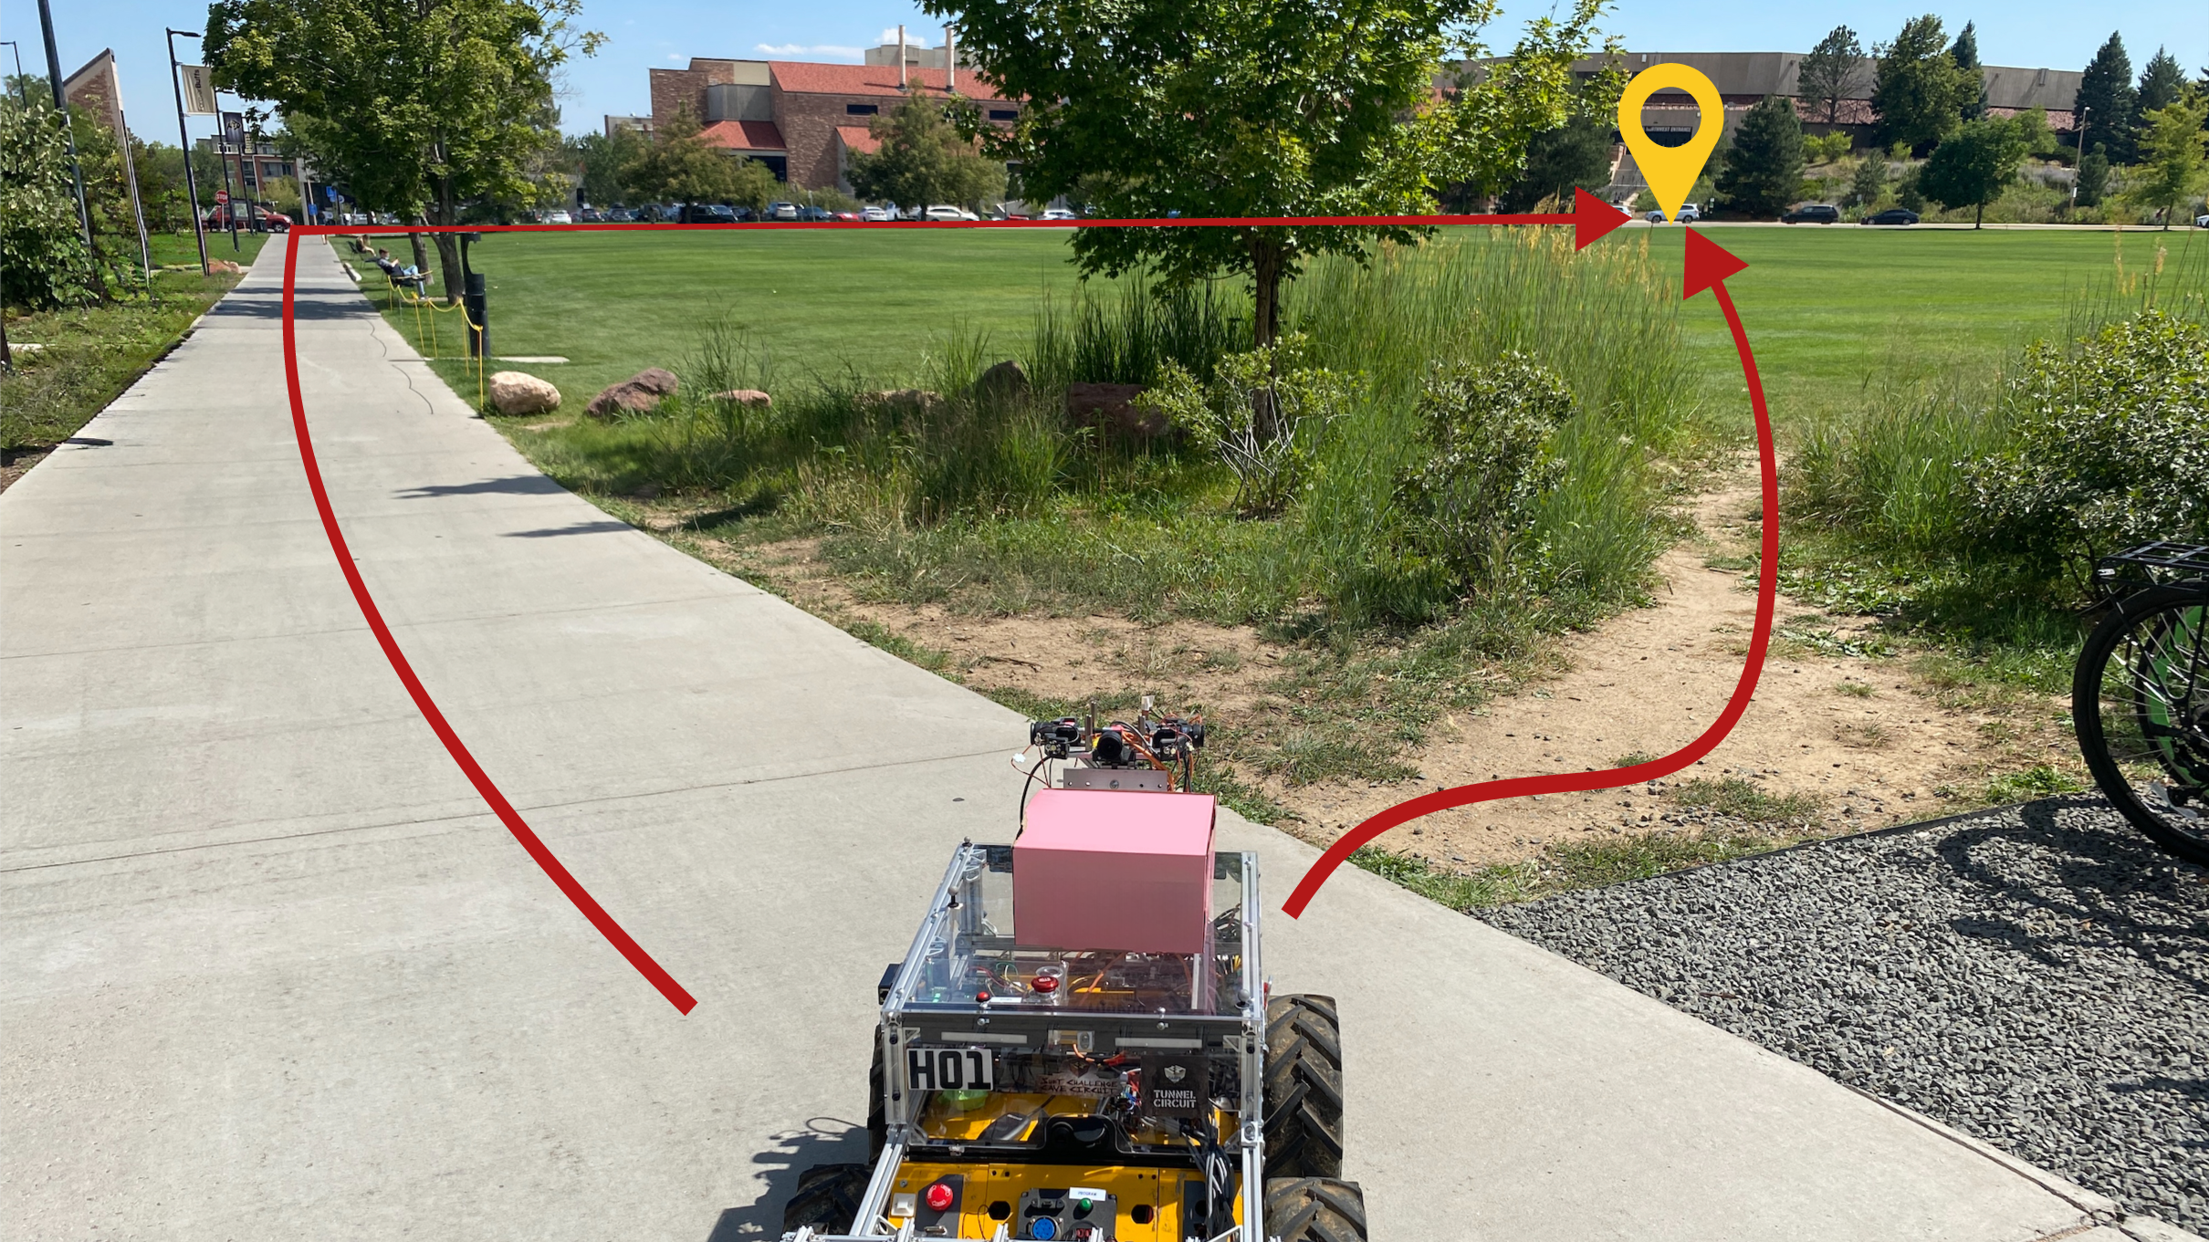

Travel Time
Distance
Terrain Type
Energy Efficiency
Notes:
The robot has different routes it can take to reach its destination. But the decision to find the optimal route depends on a number of factors such as the travel time, the terrain the robot is traversing on, how much energy the robot has to spend. The tradeoffs between these factors or preferences are hard to pre-specify. What if there are a lot of pedestrians on the paved road? What if this path is a little shorter?
While we can directly ask the human which route to take here, it might not be informative for new environments.
Introduce environment design. I can directly ask which route to take here, but it might not be informative for new environments. Better generalization faster. People are really good at imagining hypotheticals. What if this is a gravel path? What would you do then?`

Slide 4
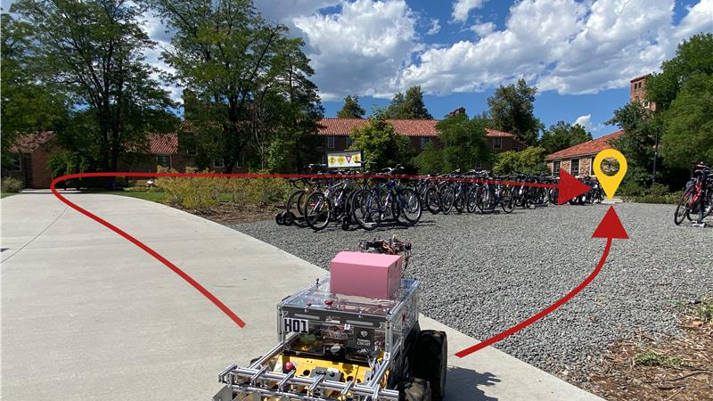


Slide 5
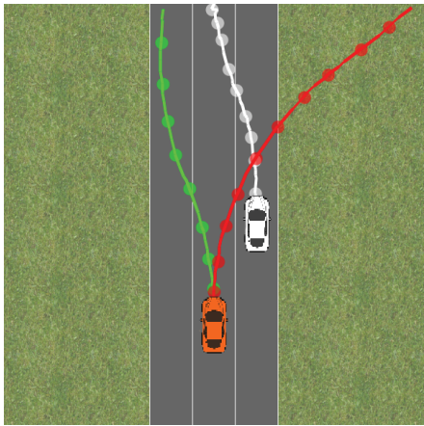






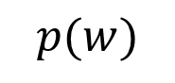
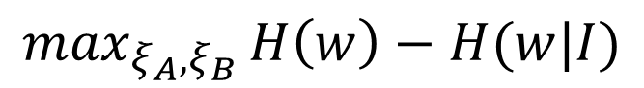

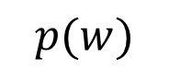
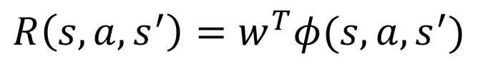

Active Preference Learning
$$R\left(s, a, s^{′}\right)=w^{T}φ(s, a, s^{′})$$
Feature Function
$$p(w)$$
$$p(w)$$
$$w$$
$$w$$
$$\max_{ξ_{A}, ξ_{B}}{H\left(w\right)−H(w|I)}$$
Entropy of distribution
Erdem Biyik and Dorsa Sadigh. "Batch active preference-based learning of reward functions." Conference on robot learning. PMLR, 2018.
Notes:
To learn a policy that adapts to human preferences, prior work uses active preference learning. We model a linear reward function and using Bayesian inference we can maintain a distribution over possible reward weights.
Define variables on slide

Slide 6

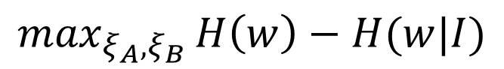
Active Preference Learning
$$\max_{ξ_{A}, ξ_{B}}{H\left(w\right)−H(w|I)}$$
Pre-generated set of trajectories from random rollouts [1]
Rollouts from replay buffer [2]
Limitations
Sample inefficient for long horizon problems
May not generalize to other environments
Erdem Biyik and Dorsa Sadigh. "Batch active preference-based learning of reward functions." Conference on robot learning. PMLR, 2018.
Kimin Lee, Laura M. Smith, and Pieter Abbeel. "PEBBLE: Feedback-Efficient Interactive Reinforcement Learning via Relabeling Experience and Unsupervised Pre-training." International Conference on Machine Learning. PMLR, 2021.
Notes:
6

Slide 7
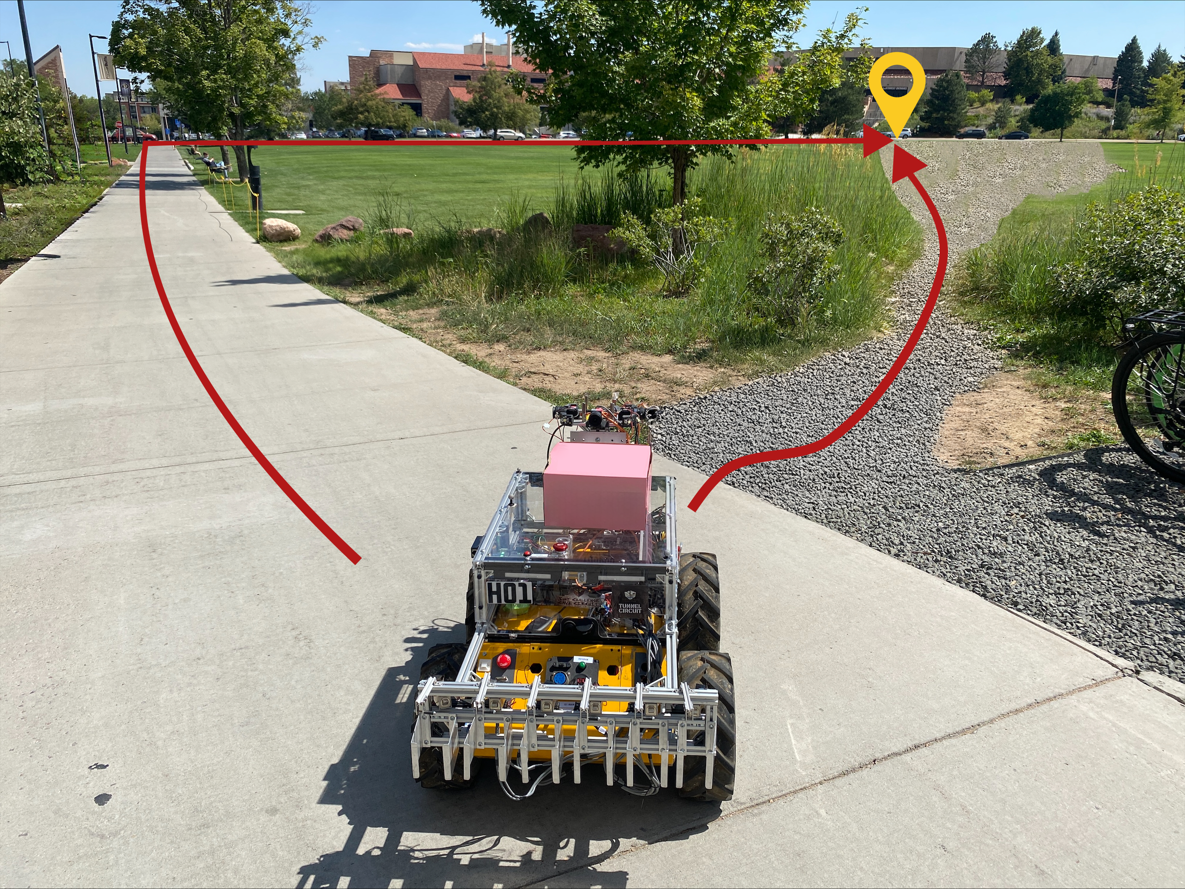
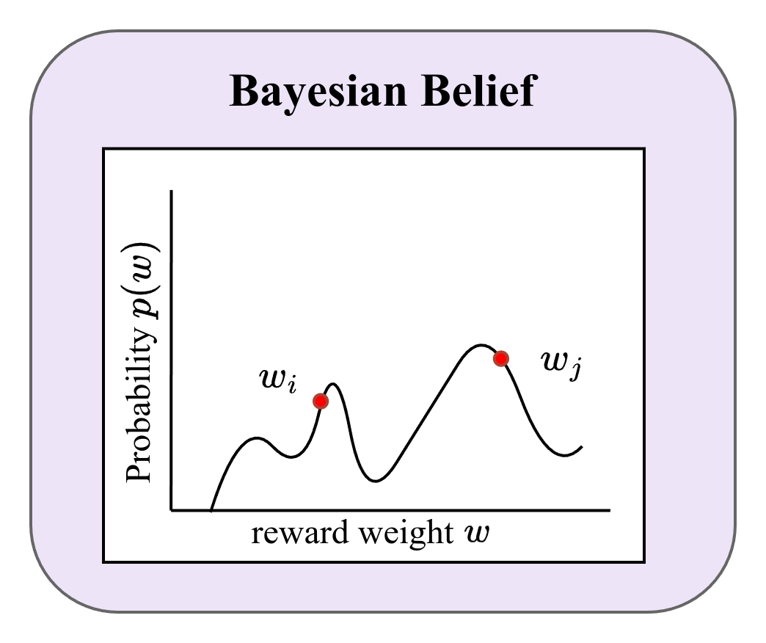
Contribution #1: Counterfactual Reasoning
Consider possible reward functions from current belief
Directly compare trajectories from different preferences
Notes:
Hard to read Bayesian belief graph

Slide 8
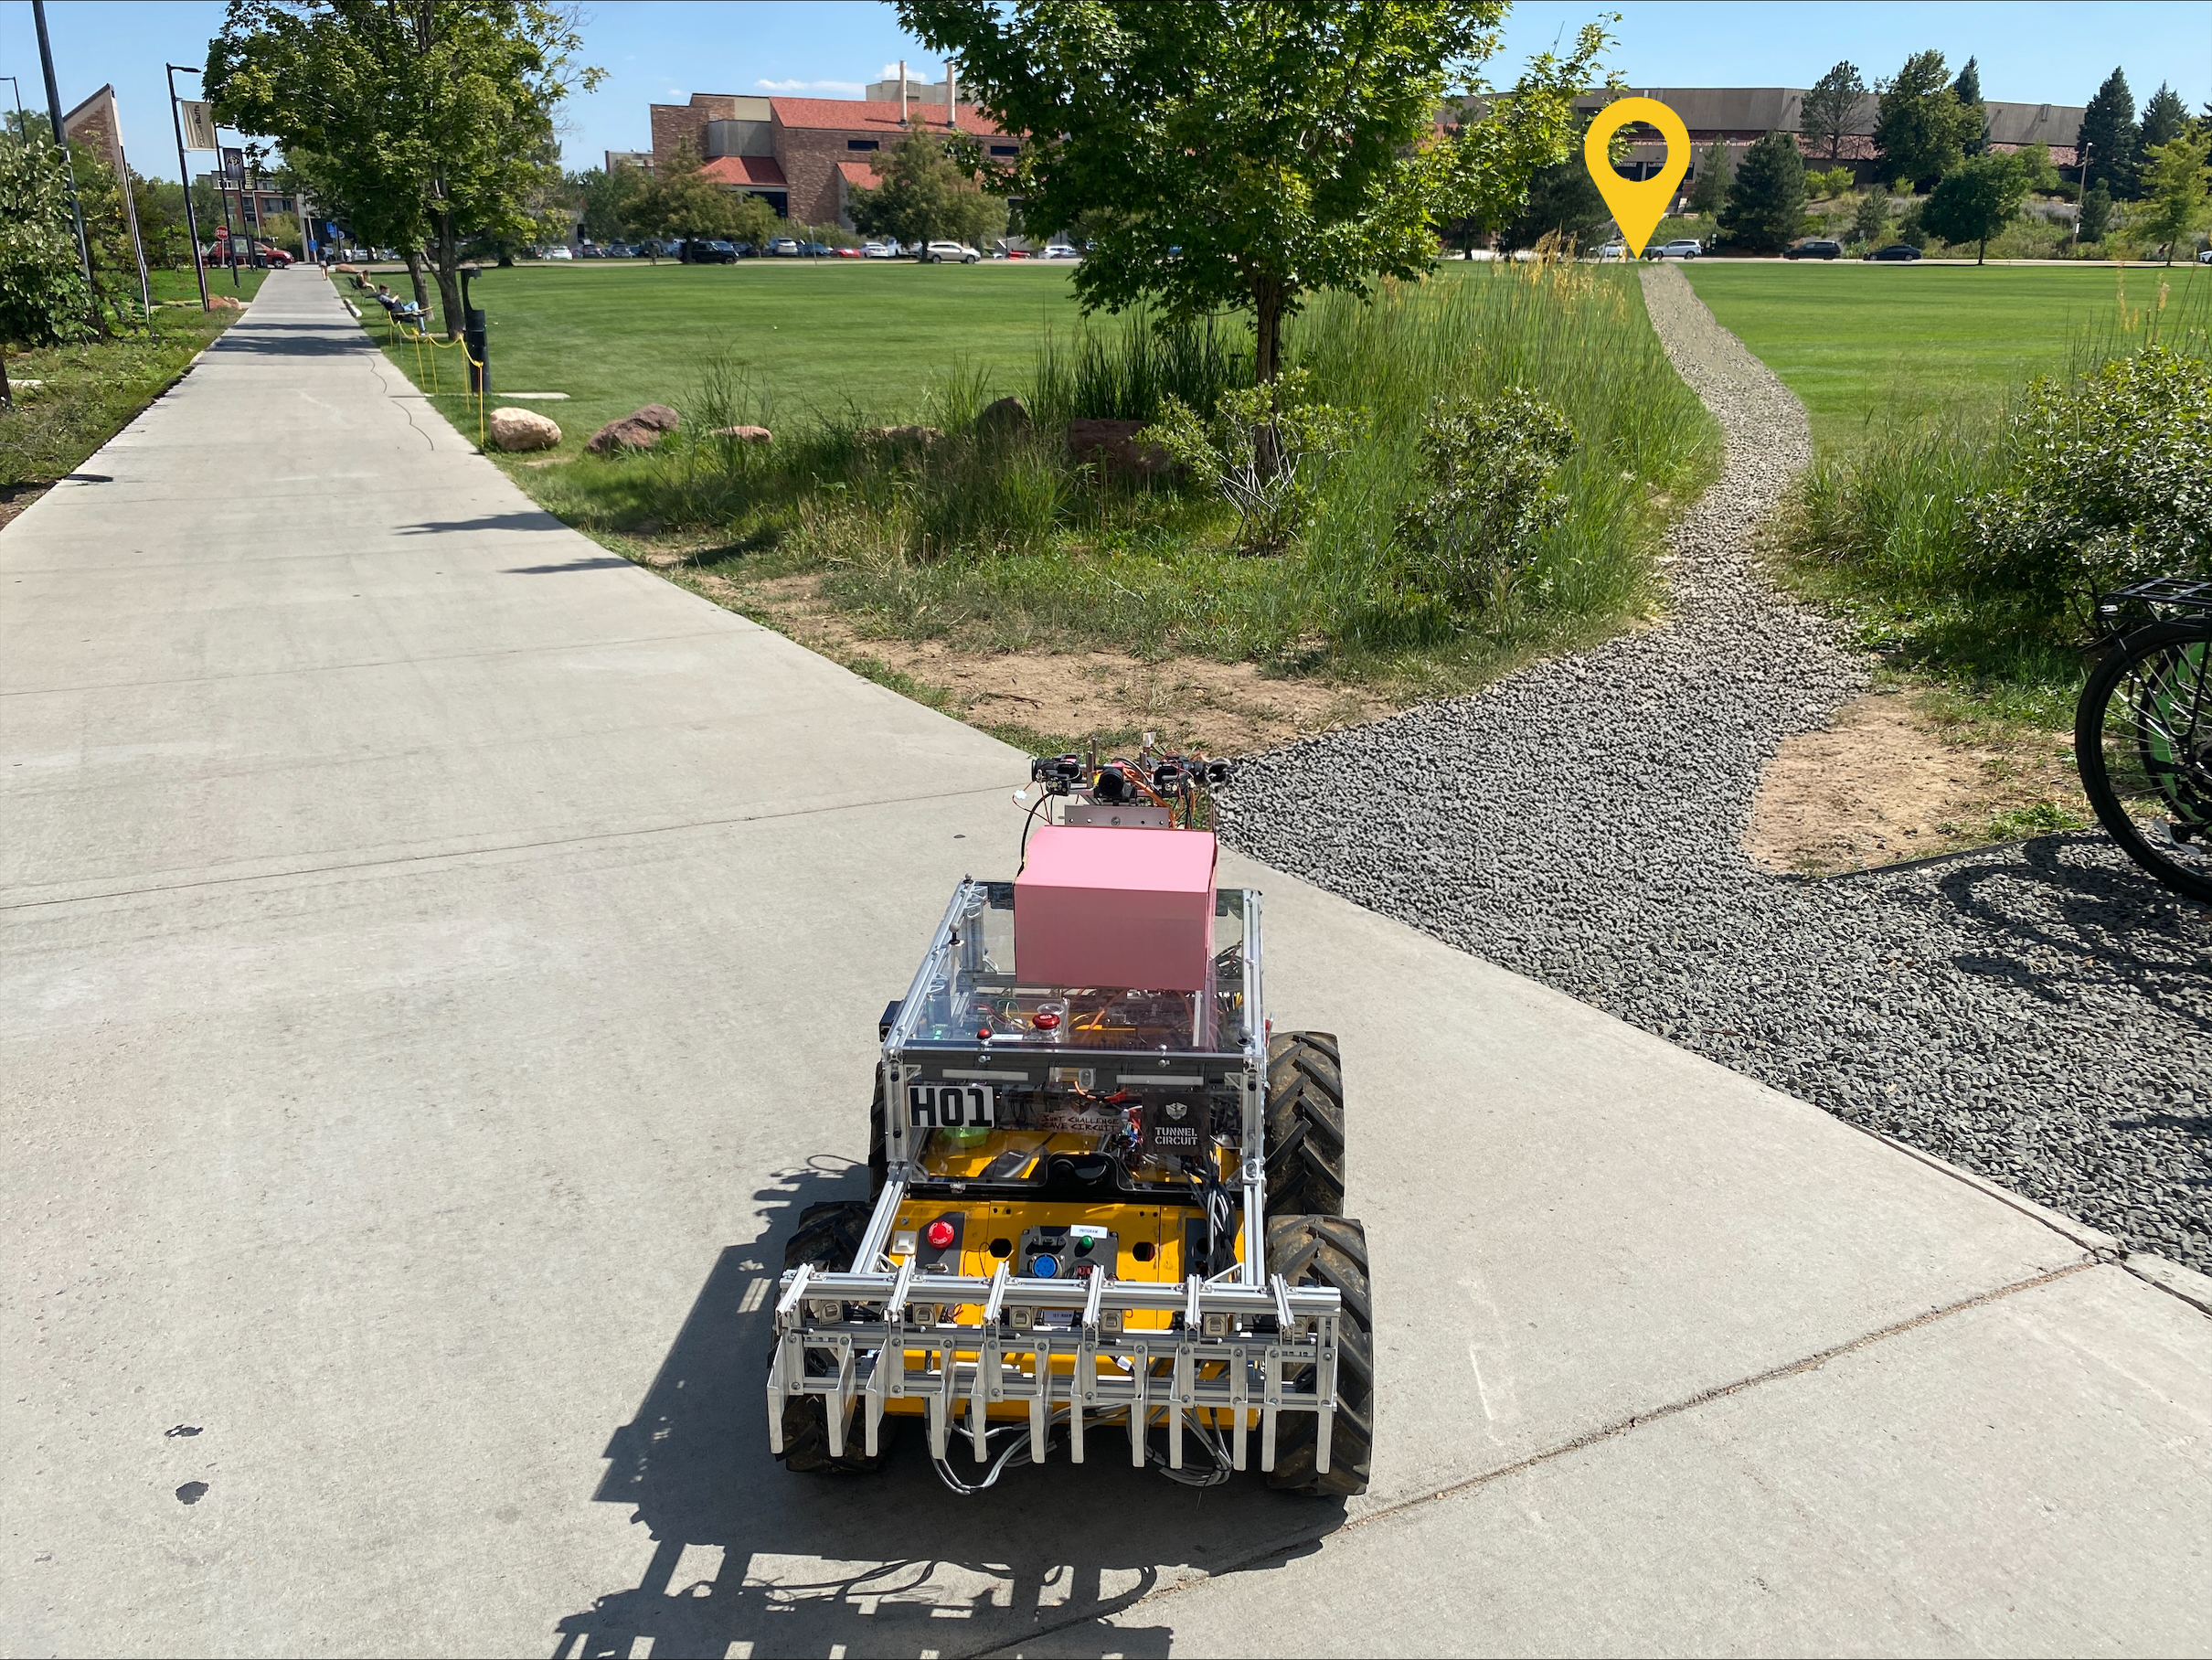
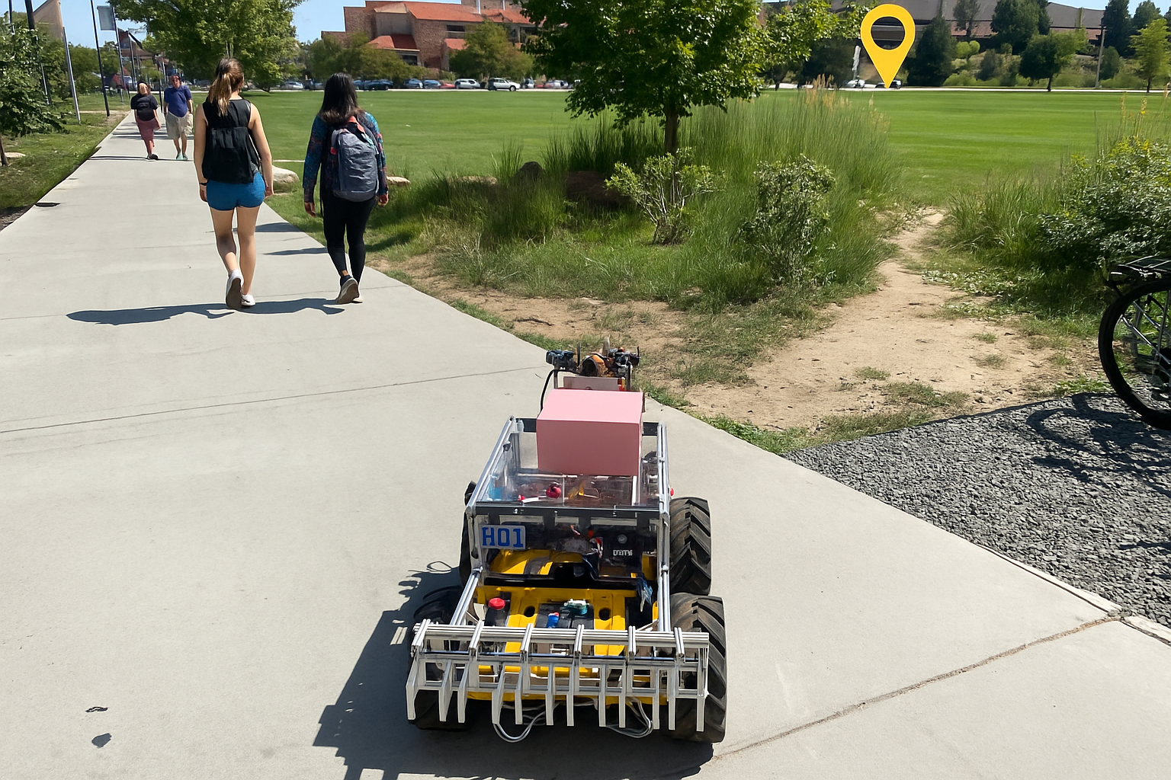
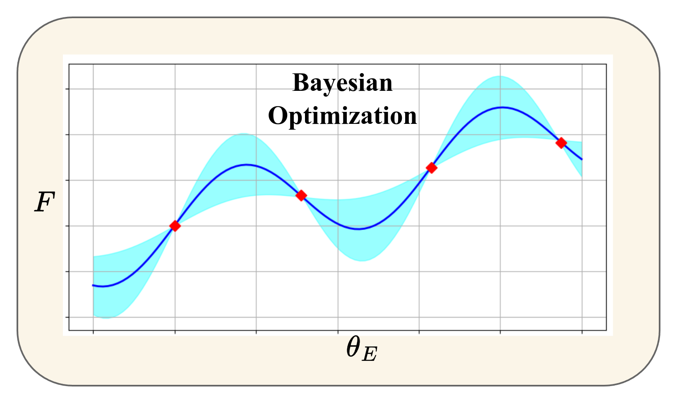
Contribution #2: Environment Design
"Imagines" new scenarios to elicit human feedback
Notes:
Scenarios should be more specific
Title for Bayesian optimization, what is this showing

Slide 9
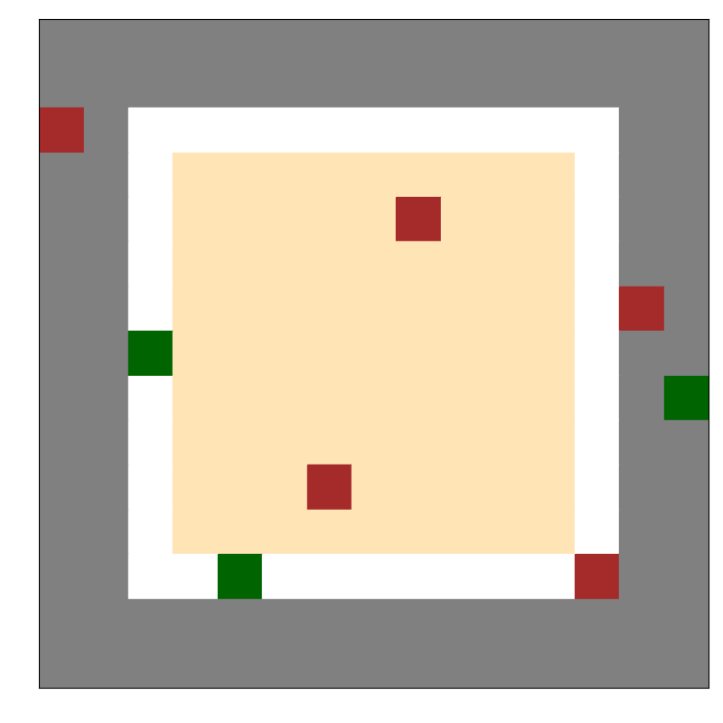
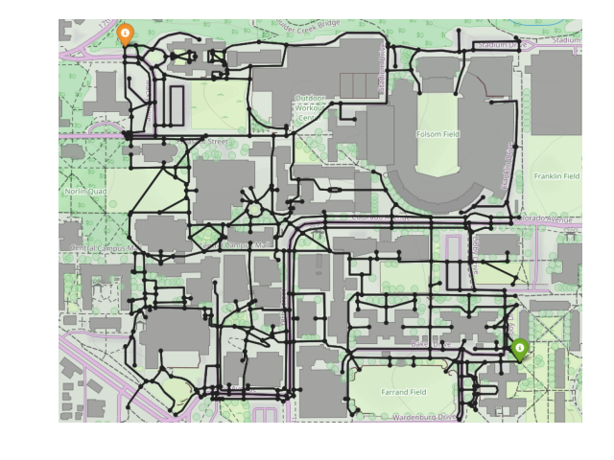
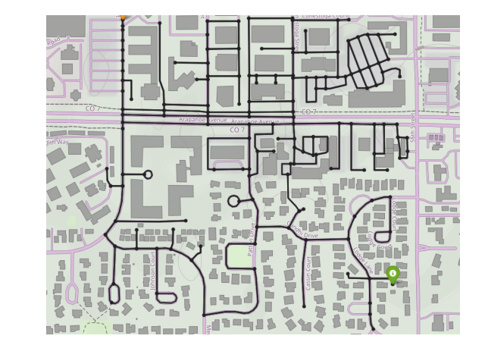
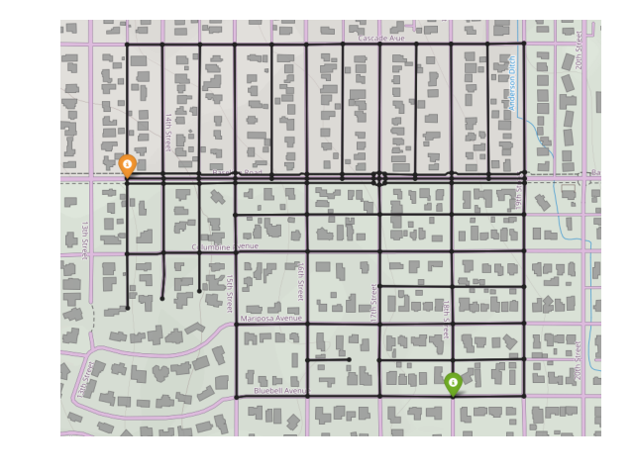
Experiments
Gravel
Grid World Navigation
Features – type of terrain
OpenStreetMaps
Features – distance, time, elevation (+/-)
Brick
Paved road
Grass
Dirt

Slide 10
Baselines
RR – pre-generated set of trajectories from random rollouts [1]
MBP – train policy using mean of current belief and run rollouts [2]
MBP + ED – environment design with MBP
CR – counterfactual reasoning only
Erdem Biyik and Dorsa Sadigh. "Batch active preference-based learning of reward functions." Conference on robot learning. PMLR, 2018.
Paul Christiano, Jan Leike, Tom Brown, Miljan Martic, Shane Legg, and Dario Amodei. Deep reinforcement learning from human preferences. Advances in neural information processing systems, 30, 2017.
Notes:
Fix citations

Slide 11
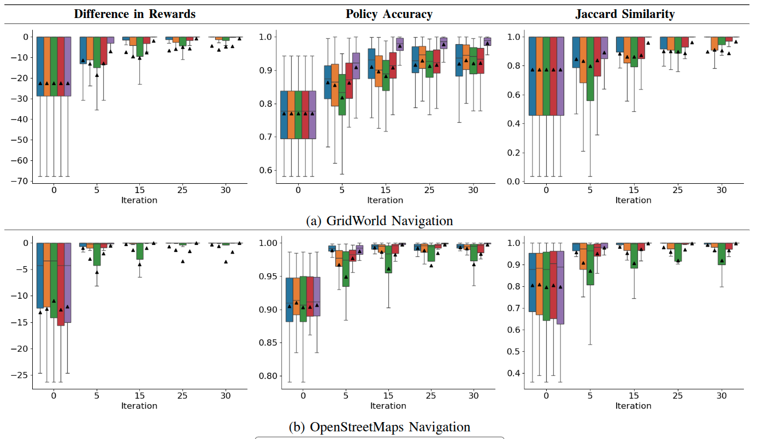

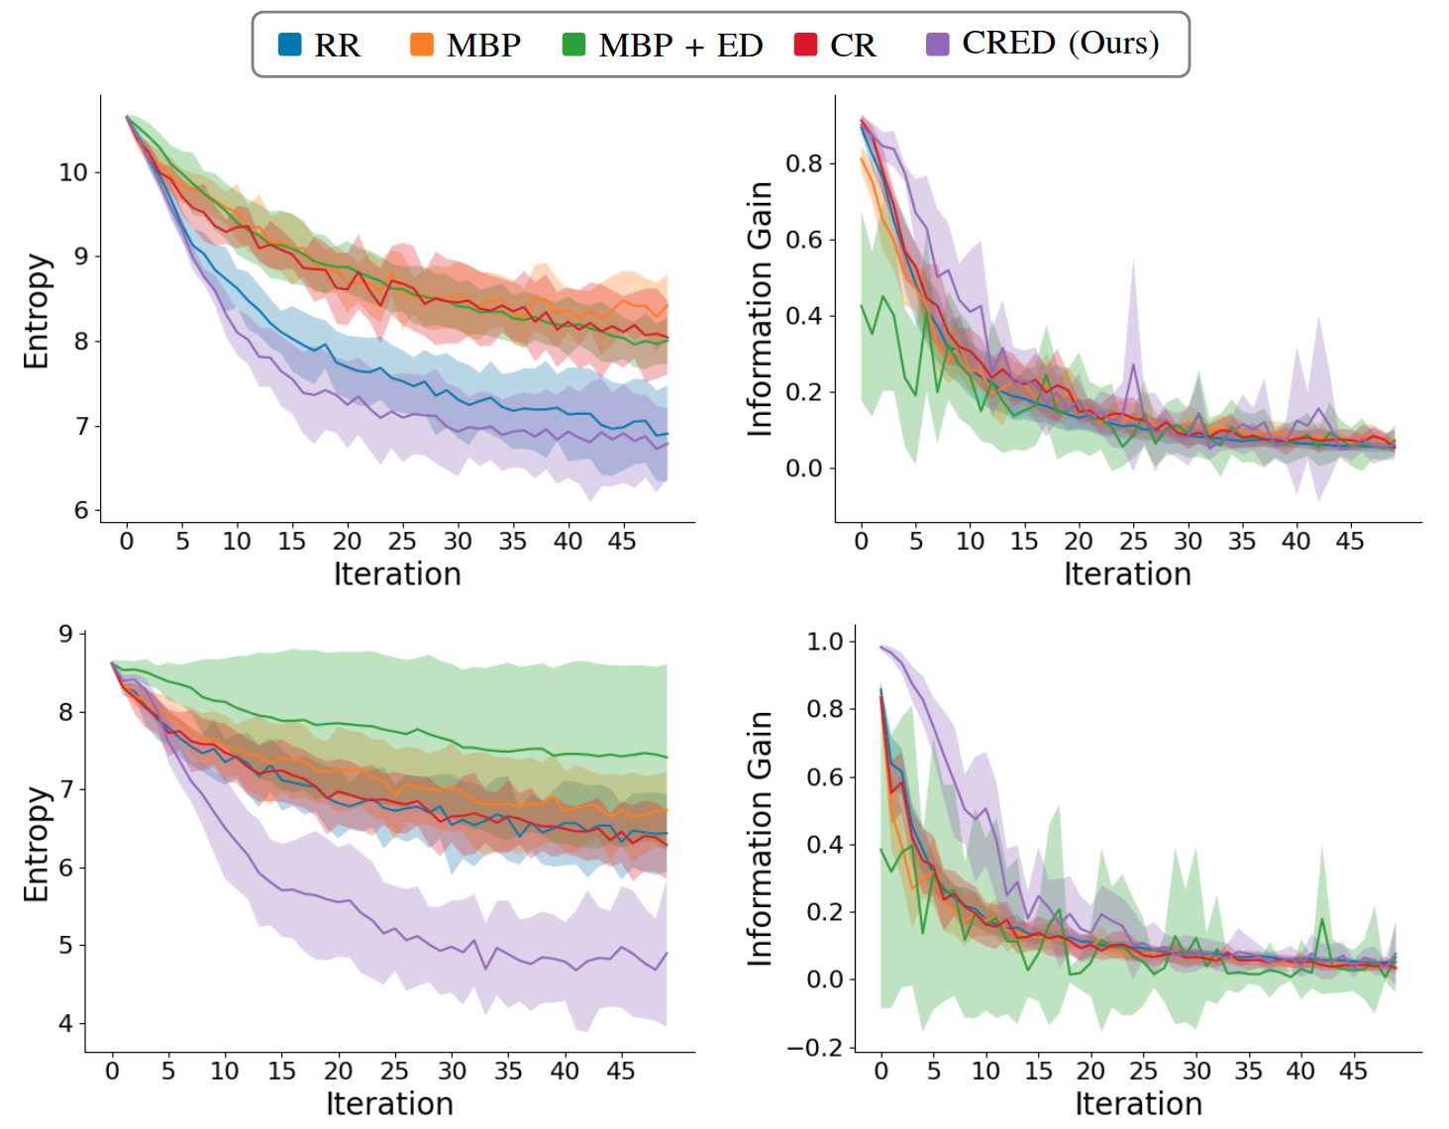
CRED converges faster with higher accuracy.
Grid World Navigation
b) OpenStreetMaps
Notes:
Why pick iteration 15? To show how much more sample efficient, let’s take a look at half way through. CRED is the one on the right.
Zoom in, make legend bigger

Slide 12



CR's queries better represent different preferences.
Mean Belief Policy (MBP)
Counterfactual Reasoning (CR)
CRED (Ours)
Notes:
MBP – rollouts from a single policy
Preference for going on grass and dirt vs gravel
Define acronyms

Slide 13
Conclusion
Counterfactual reasoning generates queries that resemble different human preferences
Environment design generates new scenarios
CRED has better sample efficiency compared to baselines shown in Grid World and OpenStreetMaps navigation

Slide 14
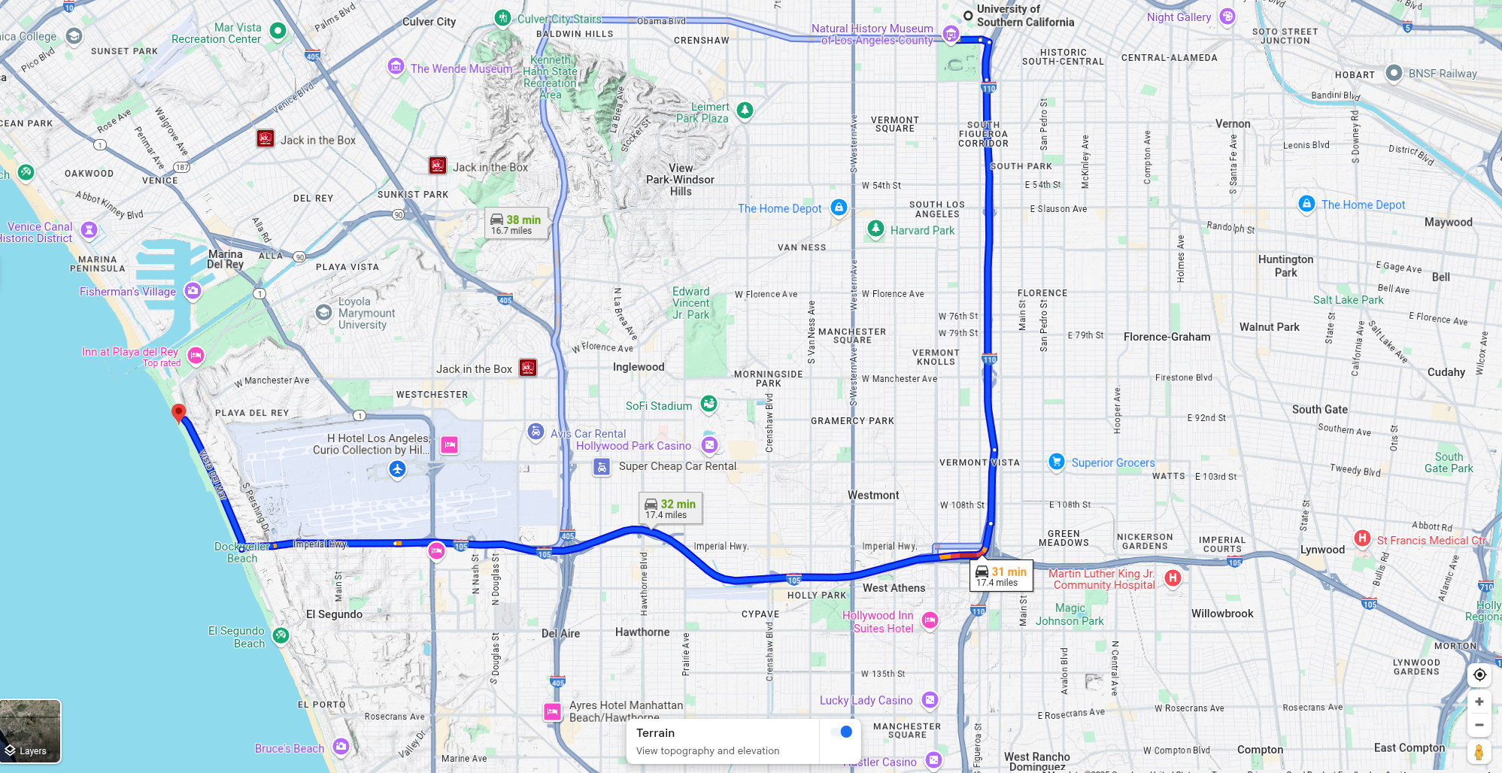


Notes:
And these preferences vary across different individuals. If you want to travel from the campus to the beach, you might want to get there as fast as possible or you might want to avoid traffic congestion and take a more scenic route.

Slide 15

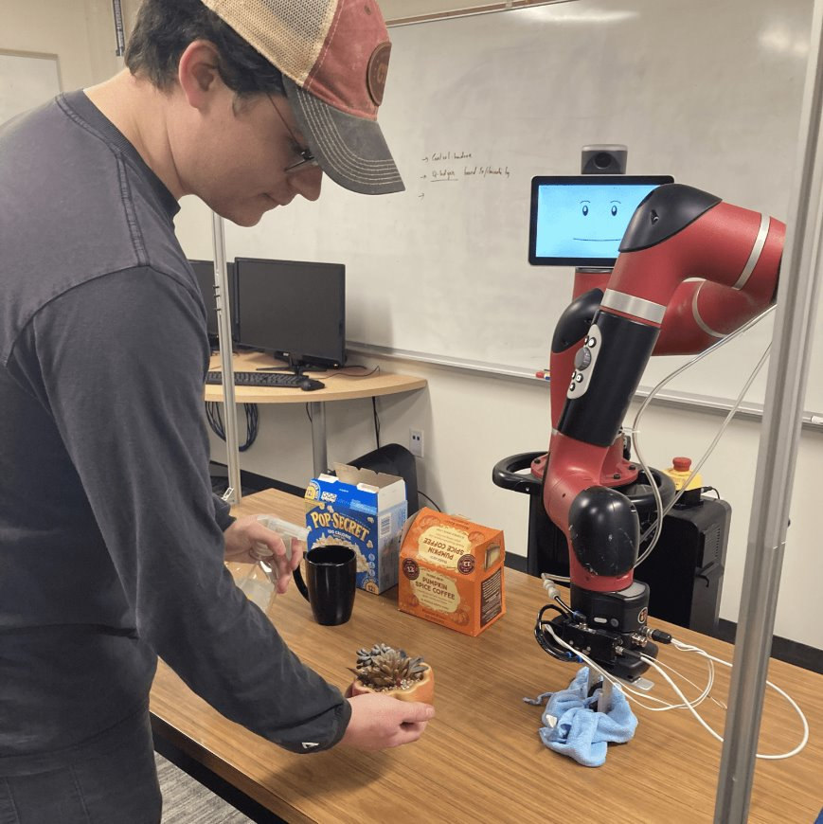
Robots should adapt to human preferences

Slide 16
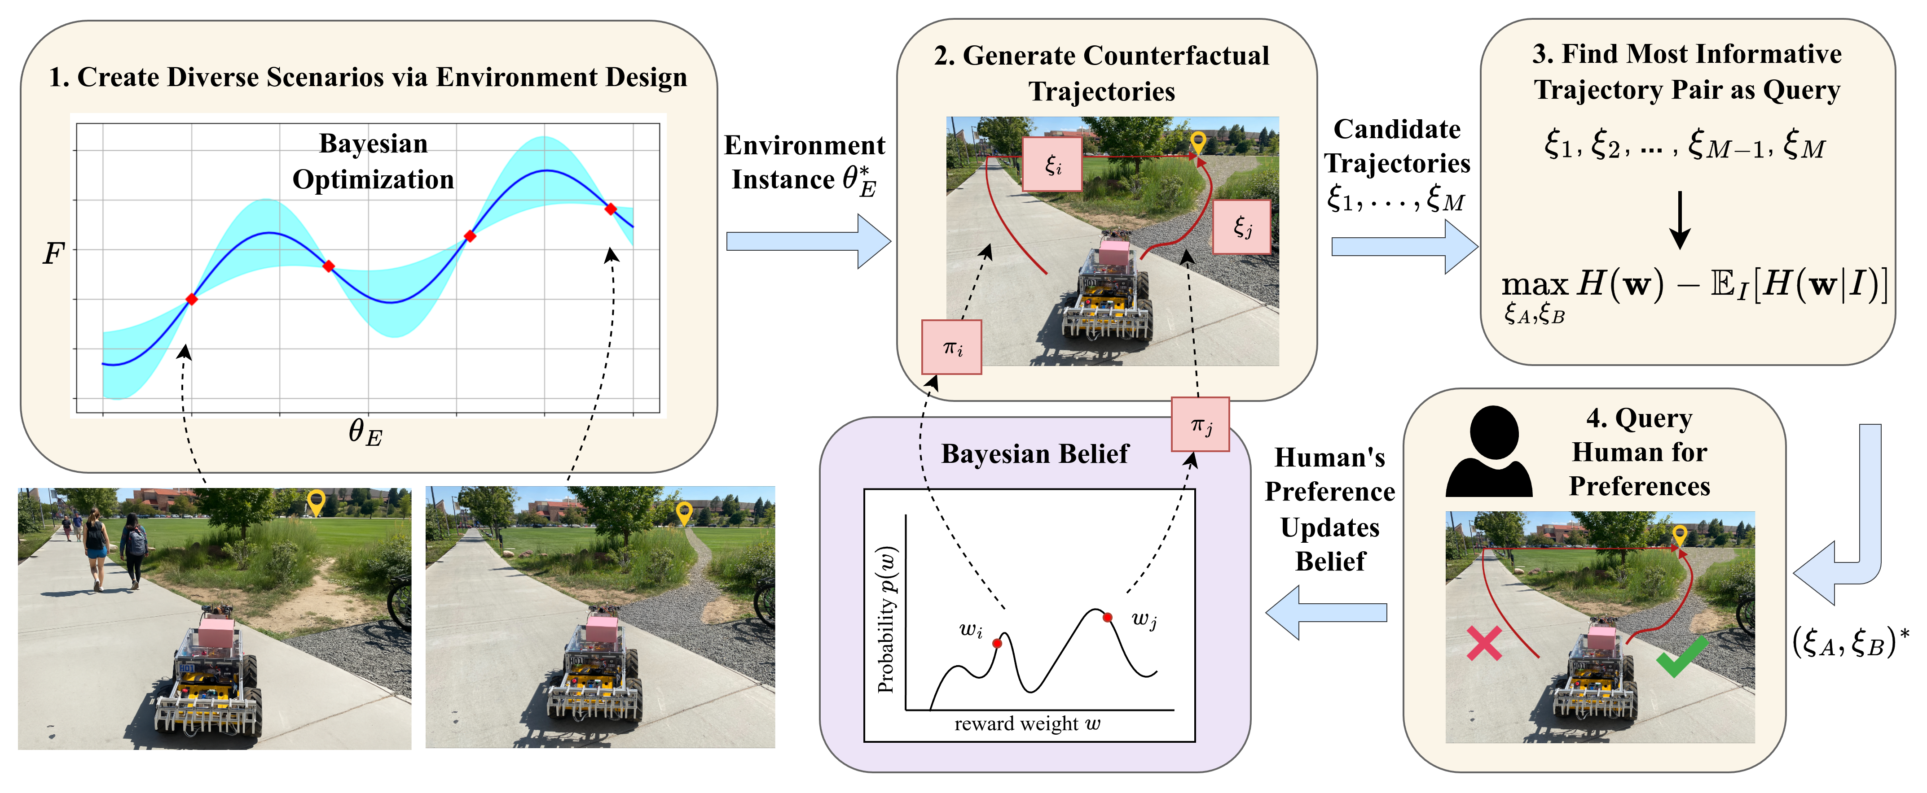
Approach: CRED

Slide 17

Research Questions
H1: CRED learns more accurate rewards with fewer iterations compared to baselines.
H2: Counterfactual reasoning generates queries with trajectories that better represent different preferences.

Slide 18
CRED generates queries with higher information gain, supporting H1.

